Slide 1
Large Scale Modeling with the Brain Modeling Toolkit and SONATA
Anton Arkhipov, Associate Investigator
Notes:
Choose one of slides 1-4 as your title slide

Slide 2
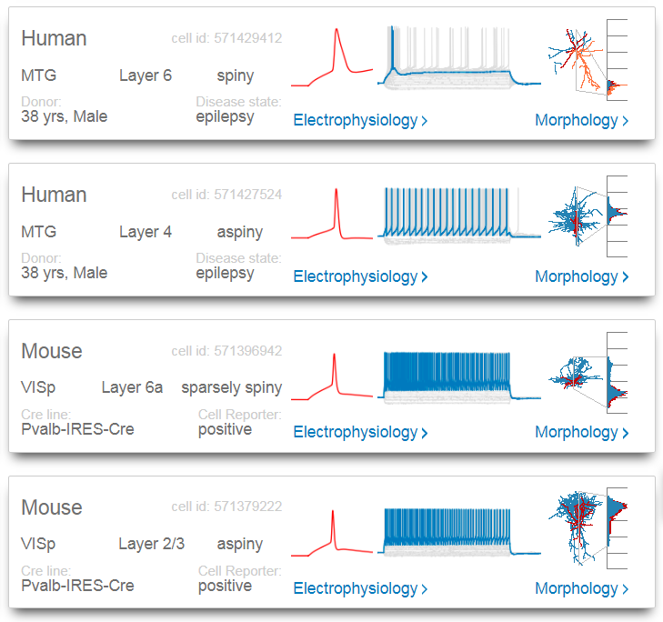
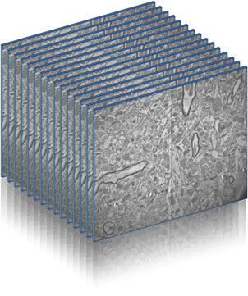
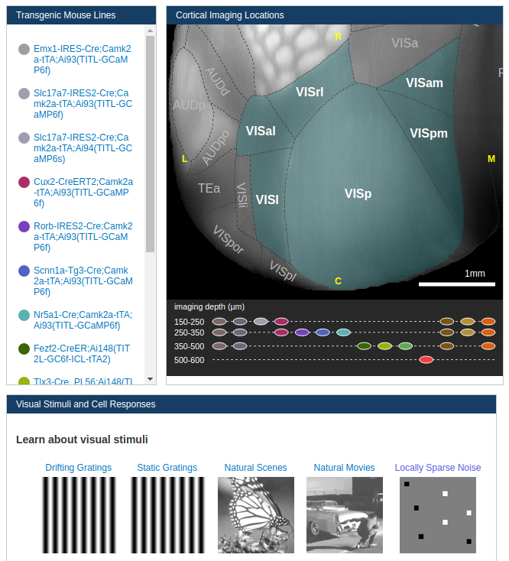
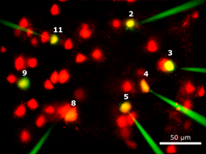
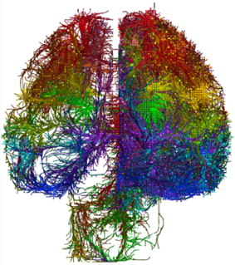
Experimental Pipelines at the Allen Institute
Cell-Type Data
Allen Cell Types Database
https://celltypes.brain-map.org/
Electrophysiology Data
Cell Morphology
Transcriptomic Data
Connectivity Data
Allen Mouse Brain Connectivity Atlas
MICrONS
https://portal.brain-map.org/explore/connectivity
Whole-brain mesoscale connectivity
Ultrastructural connectivity using EM
Synaptic physiology
Recordings in vivo
Behavioral Circuits and Sensory Processing
https://portal.brain-map.org/explore/circuits
Optical Physiology
Electrophysiology with Neuropixels

Slide 3
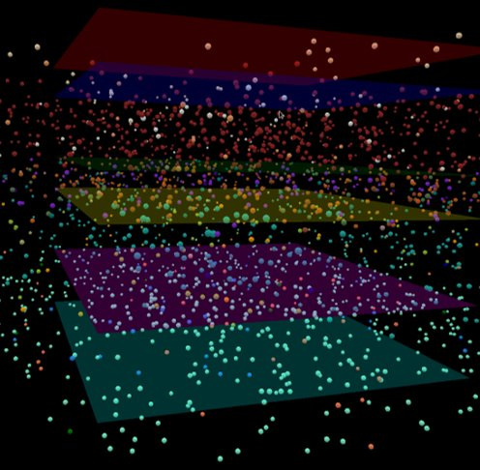
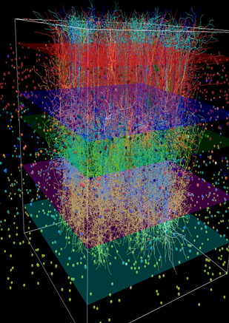
Experimental Pipelines at the Allen Institute
Using this data we can create large-scale network models and simulations of the brain, which can in turn be used to drive future experiments.
Cell-Type Data
Connectivity Data
Recordings in vivo

Slide 4
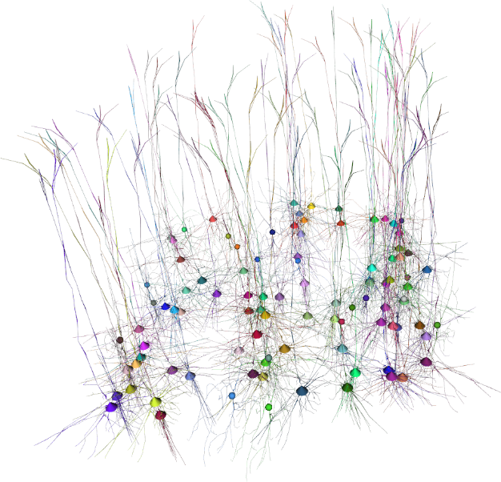
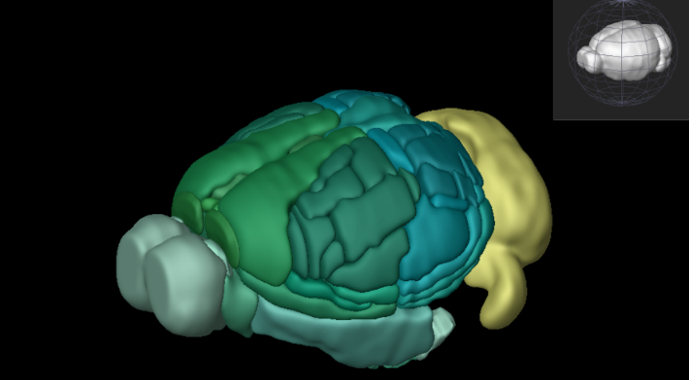
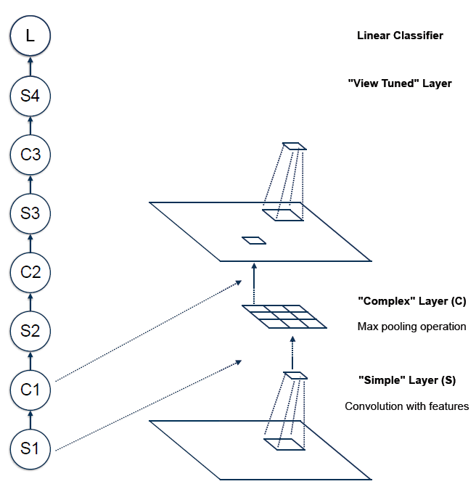
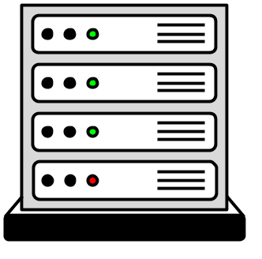
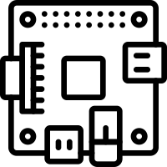
Requirements
Need a tool that can work uniformly across multiple levels of resolution
Detailed
Abstract
Need to work seemless on small to large-scale networks - with easy support for parallelized simulations

Slide 5
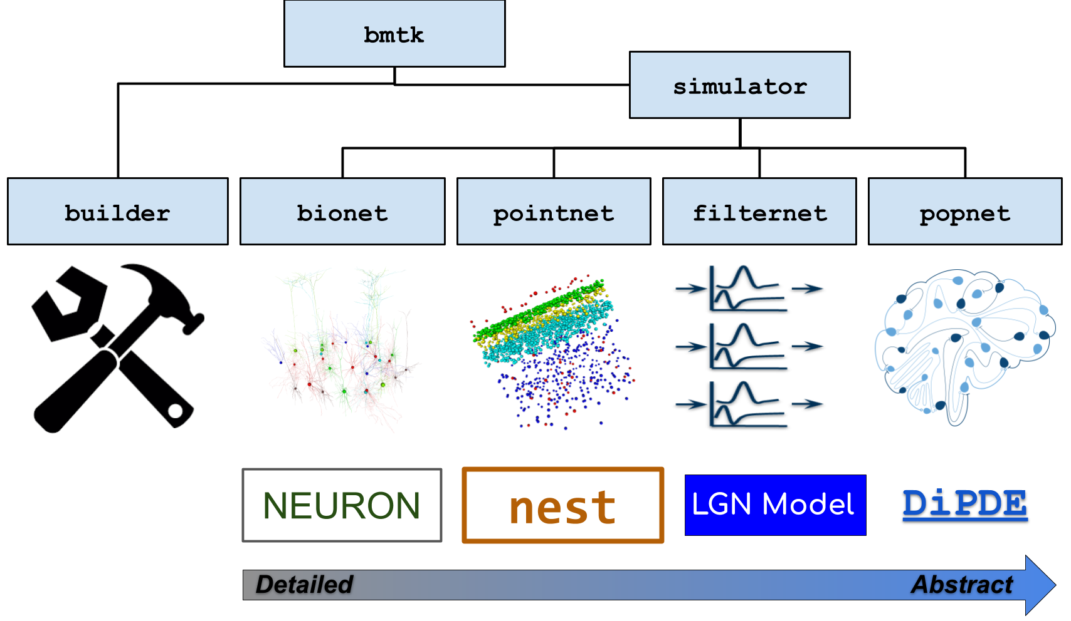
Solution: The Brain Modeling Toolkit (BMTK)
A Python based software package for building, simulating and analyzing large-scale network models across different levels of resolution.
Provides a unified interface for building, simulating and analyzing networks across a variety of simulators.

Slide 6
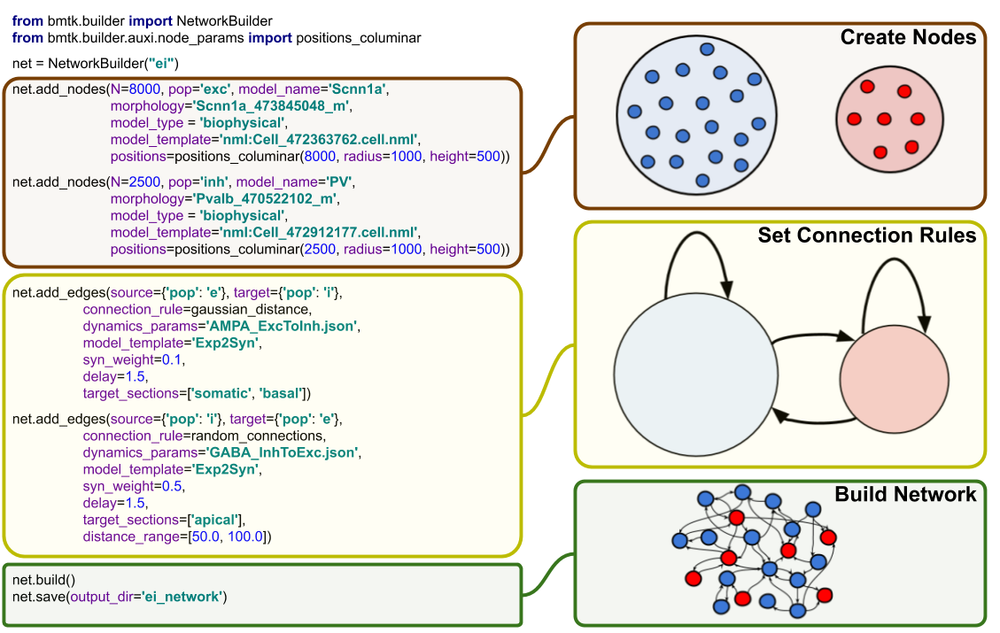
BMTK: The Network Builder
A Python API for building and saving large-scale network models
Used across different types of networks (multi-compartment, point-neuron, population models).
Allows for custom attributes and parameters as required by modelers
Saves network in a cross-platform open format (SONATA).

Slide 7
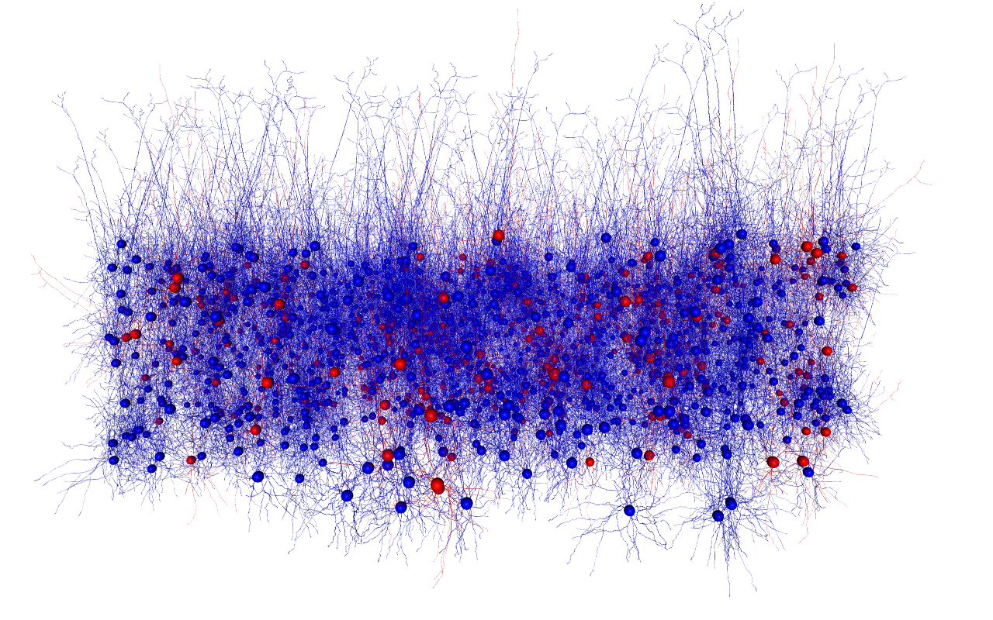
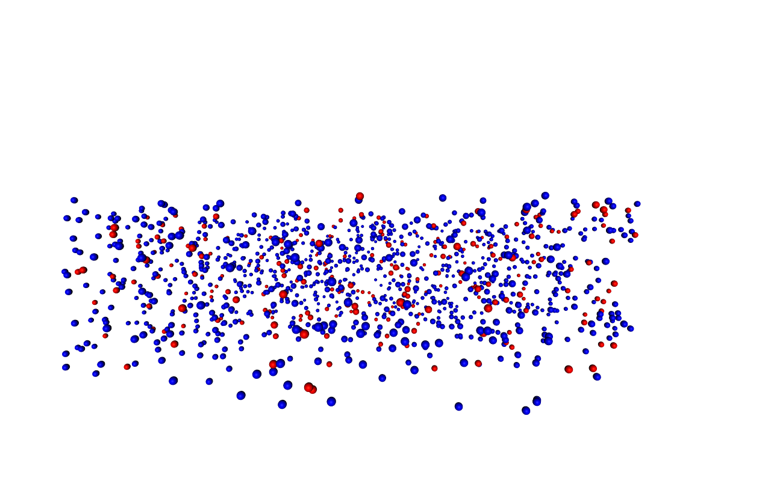
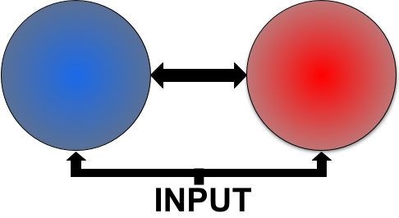
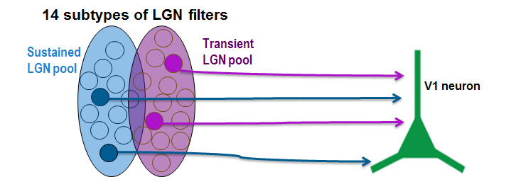
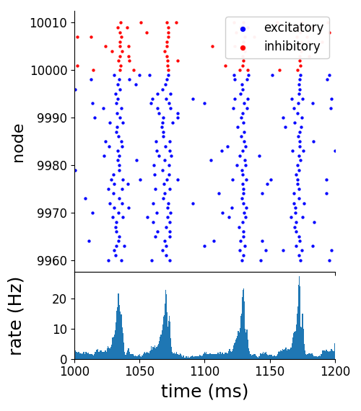
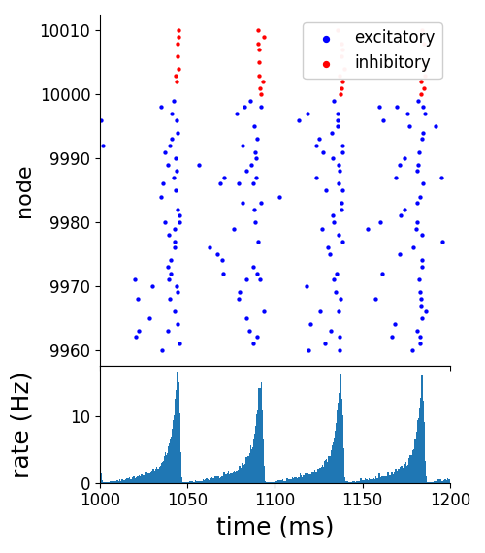
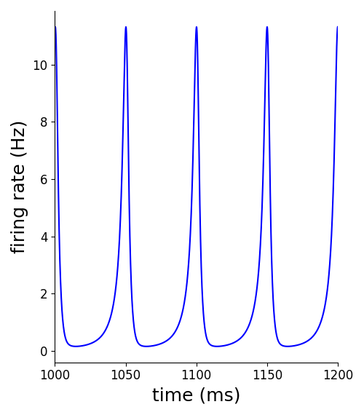
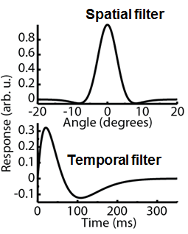
BMTK: Simulators
Provides a number of front-end interfaces to existing simulation software. Allows modelers to run the same network across different levels of resolution, and without having to learn a new tool. Automatic support of parallel simulation.
BioNet
A NEURON based Interface for running multicompartment models
PointNet
A NEST based Interface for running point-process models
PopNet
Uses The DiPDE simulator to model firing rate dynamics of neuronal populations
FilterNet
Uses filters to convert stimuli to firing rates and spikes on a receptive field

Slide 8
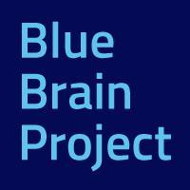
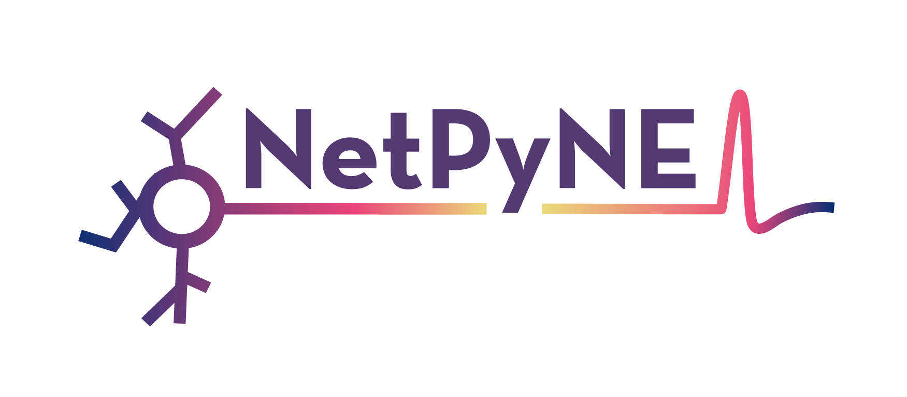
Concerns and opportunities
Our goal was to develop large, detailed, and highly optimized networks that could be simulated in a variety of conditions.
For speed and reproducibility, BMTK would save the fully instantiated network properties and attributes to the disk (rather than rebuilding from the mathematics principles during each simulation).
By divorcing the model from the software, other people could simulate, analyze, and visualize our networks using their own software.
We teamed up with the Blue Brain Project at EPFL, with contributions from the developers of Open Source Brain, NetPyNE, PyNN, and Neurodata without borders.

Slide 9
Solution: SONATA Scalable Open Network Architecture TemplAte (SONATA) data format
GOALS
An efficient and open format for sharing models, simulation parameters, and simulation results in a way that can be reproducible across multiple software kits.
Mainly focused on heterogeneous and fully instantiated networks.
Descriptive enough so that networks can be reliably instantiated in popular simulation tools (NEURON, NEST, …), but abstract enough to allow modelers and software developers to work with their favorite tools.
NOT a replacement for other formats (eg NEUROML, SWC, HOC, NWB). Allows networks to be integrated with existing formats when beneficial.

Slide 10
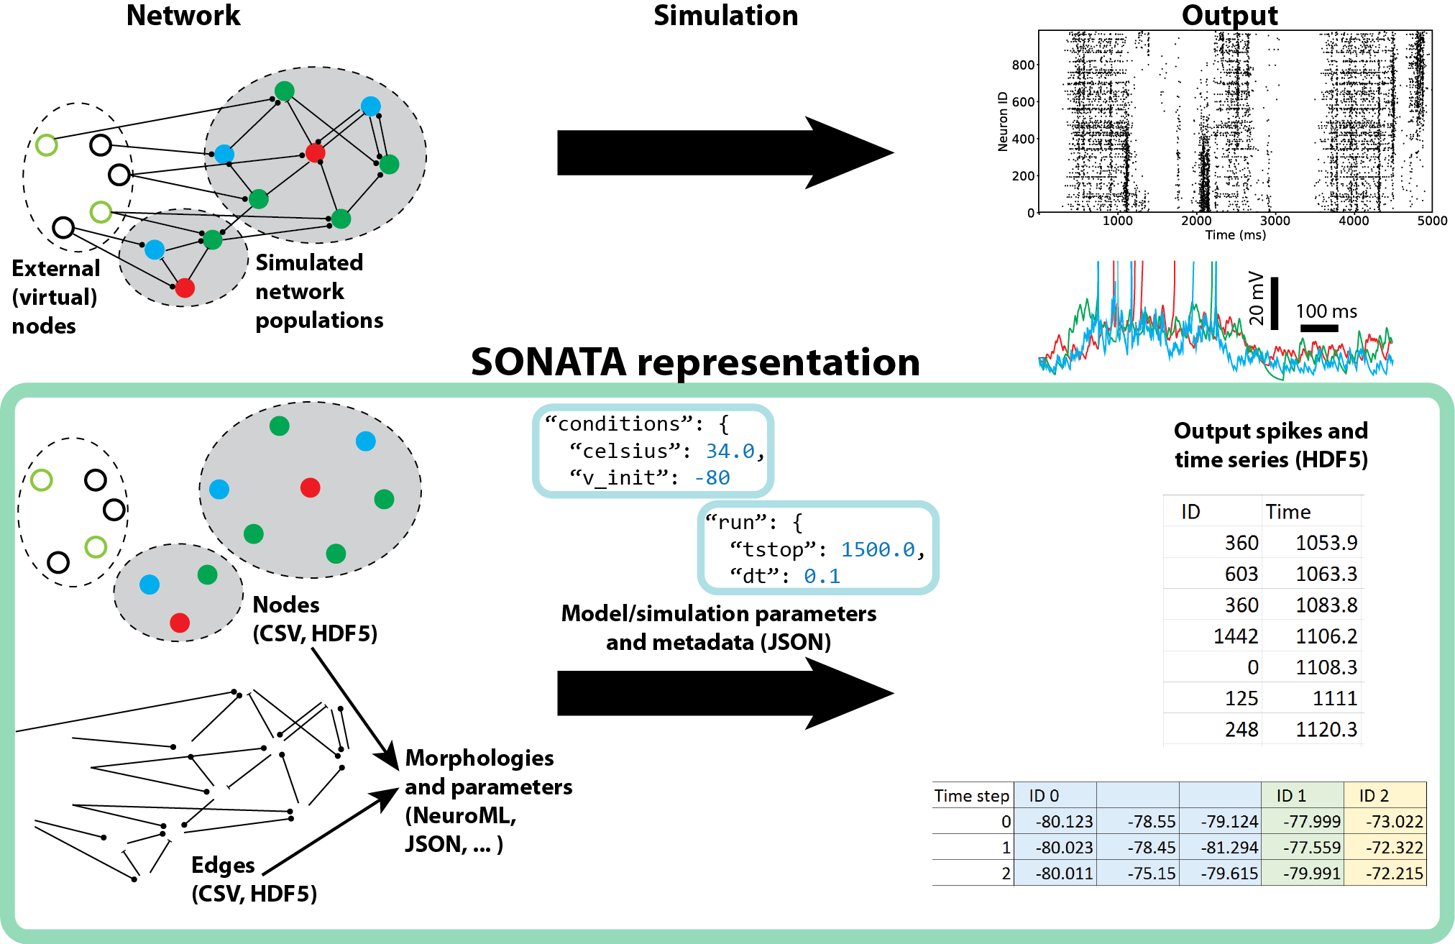
SONATA - Overview
Uses a mixture of different file formats to represent the full pipeline of building a model, running a simulation, and gathering and analyzing the results. The format can be separated into three different components:
Network Representation Uses a mixture of HDF5/CSV files to represent large heterogeneous networks
Simulation configuration
JSON based schema for instantiating simulations
Simulation results
Stores simulation results in HDF5 files

Slide 11
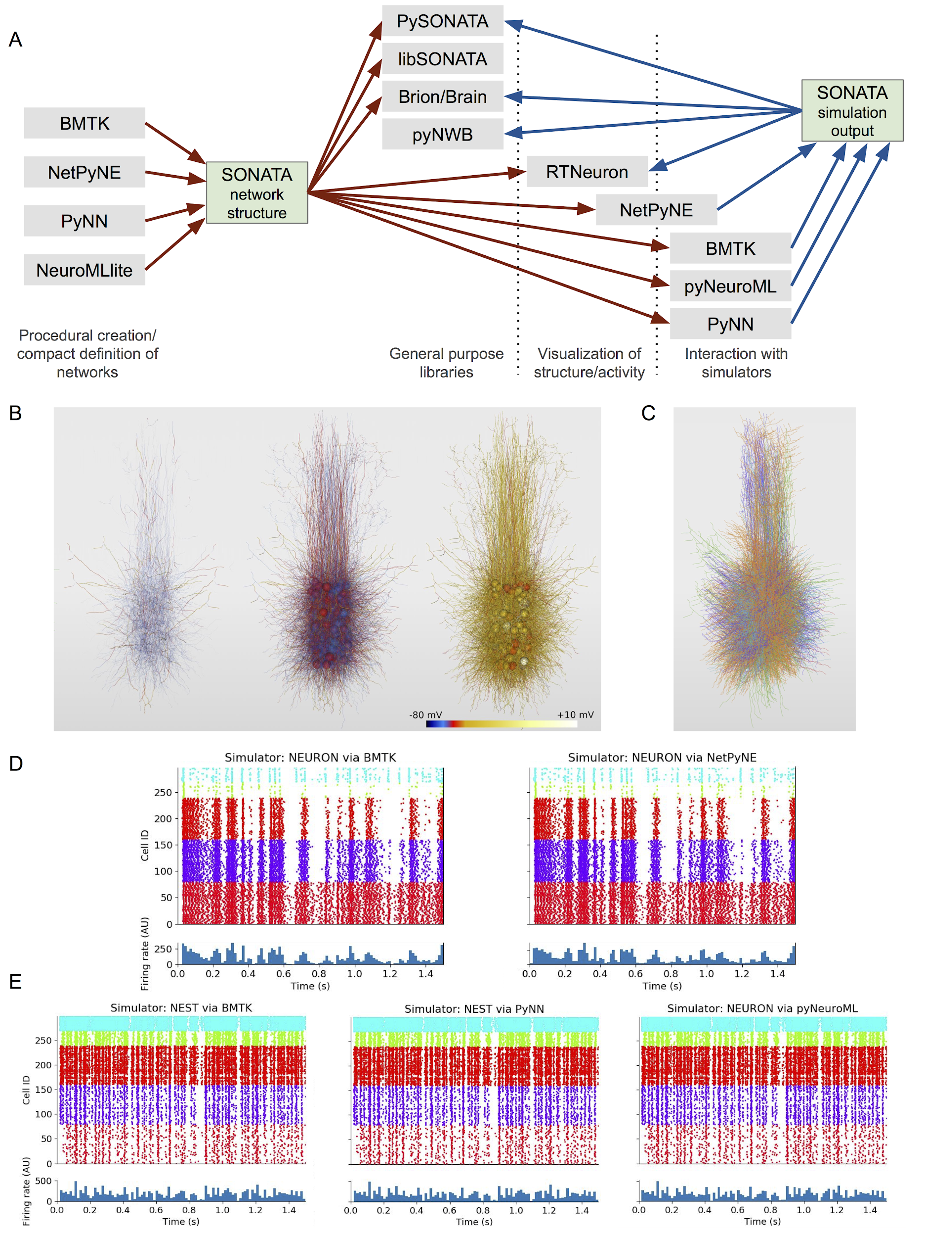
SONATA - Cross Platform Support
Libraries for reading and writing SONATA
pySONATA (Allen Institute) - Python
libSONATA (Blue Brain Project) - C++ and Python
Existing Software with SONATA support
BMTK
NetPyNE
RTNeuron
NeuroMLite
PyNN
Brion/Brain
pyNeuroML
NWB (nxd-simulation-output extension)
SONATA is an evolving format and will continue to be improved and expanded to support other software and models.

Slide 12
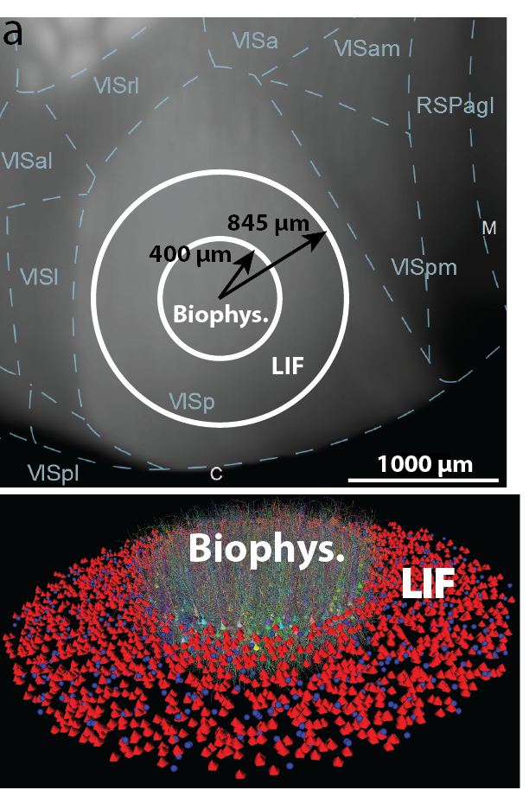
Available Mouse V1 Models https://portal.brain-map.org/explore/models
We’ve released network, configuration and simulation results are stored in the latest version of SONATA. Can be readily simulated under varying conditions using BMTK (likely require access to HPC).
Layer IV network
https://portal.brain-map.org/explore/models/l4-mv1
~45,000 cells
Mixed Biophysically detailed + point neuron models
Full V1 cortical column network(s)
https://portal.brain-map.org/explore/models/mv1-all-layers
~250,000 cells
A biophysically detailed model (BioNet)
A point-neuron network using GLIF models (Teeter 2018)

Slide 14
Using BMTK and SONATA to develop Mouse V1 Models
1. Using the BMTK Network Builder + Allen Institute pipeline data - we build an initial network and save the file in the SONATA format.
BMTK
Network Builder
SONATA
Network Files

Slide 15
Using BMTK and SONATA to develop Mouse V1 Models
1. Using The BMTK Network Builder + Allen Institute Pipeline data - we build an initial network and save the file in the SONATA format. 2. Use the SONATA configuration json format to run the network under a variety of simulations, results (spike trains, membrane potentials) are saved in SONATA format
BMTK
Network Builder
SONATA
Network Files
BMTK
Simulators (BioNet, PointNet, etc)
SONATA Sim. Results
SONATA
Config. Files

Slide 16
Using BMTK and SONATA to develop Mouse V1 Models
1. Using The BMTK Network Builder + Allen Institute Pipeline data - we build an initial network and save the file in the SONATA format. 2. Use the SONATA Configuration json format to run the network under a variety of simulations, results (Spike Trains, Membrane Potentials) are saved in SONATA format
3. Results are analyzed, update network parameters.
BMTK
Network Builder
SONATA
Network Files
BMTK
Simulators (BioNet, PointNet, etc)
SONATA Sim. Results
BMTK Analysis and visualization tools
SONATA
Config. Files

